Slide 1
Getting started on using GitHub Codespaces with your SharePoint Framework solutions

Slide 2
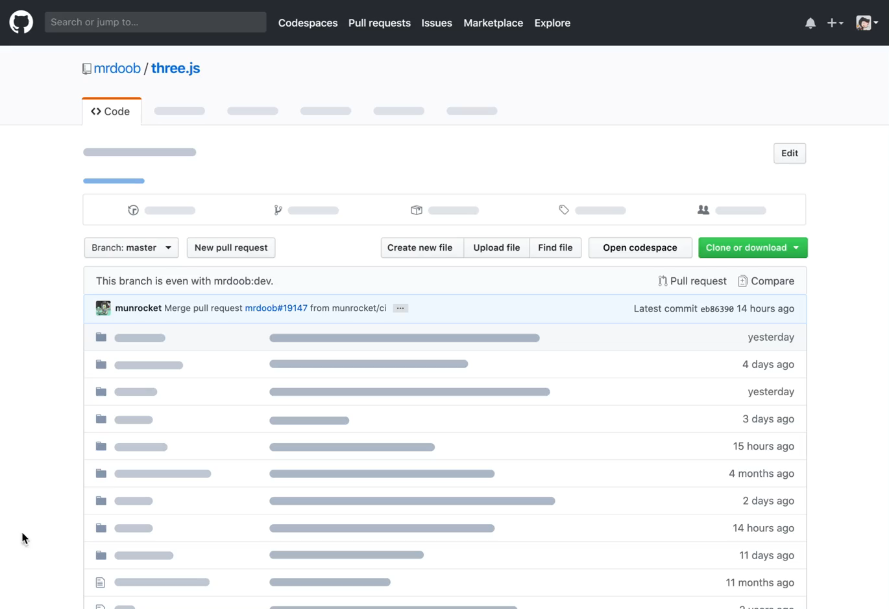
What is Github Codespaces
Ready to use development environment
Accessible from anywhere
You can develop from your cell phone!
You can develop from iPad!
Develop from your Chromebook!
Reduced configuration time
Don't keep sources local

Slide 3
What you can do with Codespaces
Every developer can create their own Codespaces
No one can access your Codespaces
Each Codespaces is associated with a project or branch
You can work directly online
You can connect to Codespaces with Visual Studio Code
You can connect to Codespaces with Visual Studio 2019/2022 (Preview)
You can configure your container as you want

Slide 4
Limits during beta
Recommended for use on Chromium-based browsers such as Chrome, Edge, Opera.
Only one type of codespace is available at the moment
Only Linux containers are supported
Only three codespaces per user

Slide 5
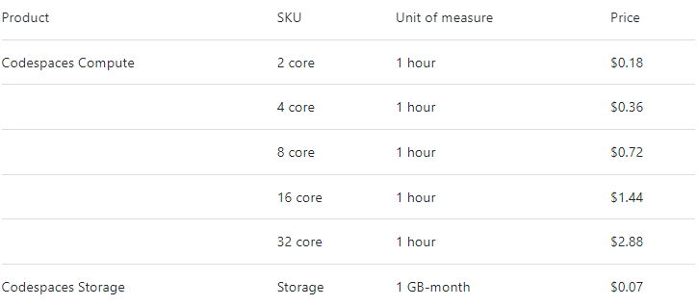
Okay, but how much does it cost?
During the beta is completely free
Afterwards you will pay for space and computing time
* if you work 8 hours a day for 20 days = $14

Slide 6
DEMO

Slide 7
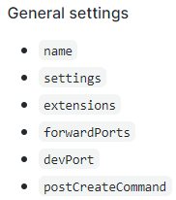
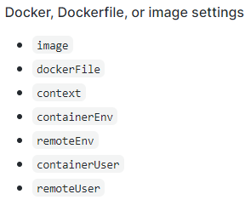
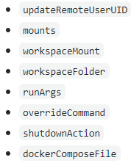
Configuring Codespaces
By default, a container with this frameworks/libraries is created: Python, Node.js, JavaScript, TypeScript, C++, Java, C#, F#, .NET Core, PHP, PowerShell, Go, Ruby, Rust
You can configure your own container with a .devcontainer.json file

Slide 8
DEMO

Slide 9
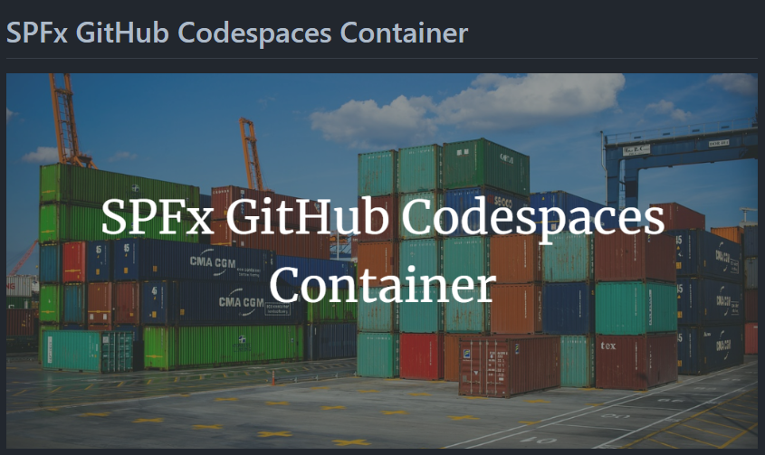
SPFx GitHub Codespaces Container

Slide 10
DEMO

Slide 11
References
https://github.com/features/codespaces
https://docs.github.com/en/free-pro-team@latest/github/developing-online-with-codespaces/about-codespaces
https://github.com/microsoft/vscode-dev-containers/tree/master/containers/codespaces-linux
https://code.visualstudio.com/docs/remote/devcontainerjson-reference
https://github.com/microsoft/vscode-dev-containers
https://github.com/features/codespaces/signup
https://github.com/kasuken/SPFxGitHubDevContainer

Slide 12




Emanuele Bartolesi
//dev.to/kasuken
emanueleb@outlook.com
//dev.to/kasuken
emanueleb@outlook.com
@kasuken
//github.com/kasuken
@kasuken
//twitch.tv/kasuken
@kasuken
//twitch.tv/kasuken
https://links.emanuelebartolesi.com

